Slide 1
Spotify Deep Dive
An analysis of Billboard’s Annual Top 10 Tracks Across Various Dependency Regimes
Brandon Ferro – Chris Newey – Keith Albrecht

Slide 2
MOTIVATION & SUMMARY
Null Hypothesis
Characteristics of popular music, as defined by Billboard’s annual Top 10 tracks list, will not show statistically significant differences across various dependency regimes
Key Questions
Are there statistically significant differences in the “characteristics” of popular music across:
time
politics
important societal issues
Conclusions
Reject Null: Characteristics differences across time are statistically significant
Reject Null: Characteristics differences across politics are statistically significant
Can’t Reject Null: Characteristics differences across societal issues are not statistically significant

Slide 3
QUESTIONS & DATA
Scope (defining “characteristics”):
“Genre” too broad, providing little analytical insight; can we quantitatively categorize things that constitute “genre” instead?
“Across time” is broad and characteristics unlikely to change materially year-to-year; group by decade
“Politics” can easily be grouped into R vs. D White House admins
“Import societal issues” is both broad and subjective; narrow by grouping into periods of war vs. peace-time
Data needed:
Billboard Top 10 tacks with accurate release dates
Music API containing characteristics info of Billboard Top 10 tracks
Lists of historical White House admins, start/end dates of major US wars
Tools used:
Billboard website
Spotify API
Wikipedia

Slide 4
DATA EXPLORATION & CLEANUP
Exploration:
Copy-paste tracks and associated release dates from Billboard website
Research Spotify API to determine what was available and how to call
Locate White House R vs. D admins and war dates
Cleanup:
Copy-paste unformatted Billboard, Wikipedia data into CSV
Export Spotify API data to CSV, manually fix release date data
Problems:
No easy-to-find or download file containing Billboard data on web
Format of Billboard website data changed 2017-2018; timely copy-paste into CSV unrealistic
Hoped to cross-reference Billboard API w/ Spotify API, but no longer operational

Slide 5
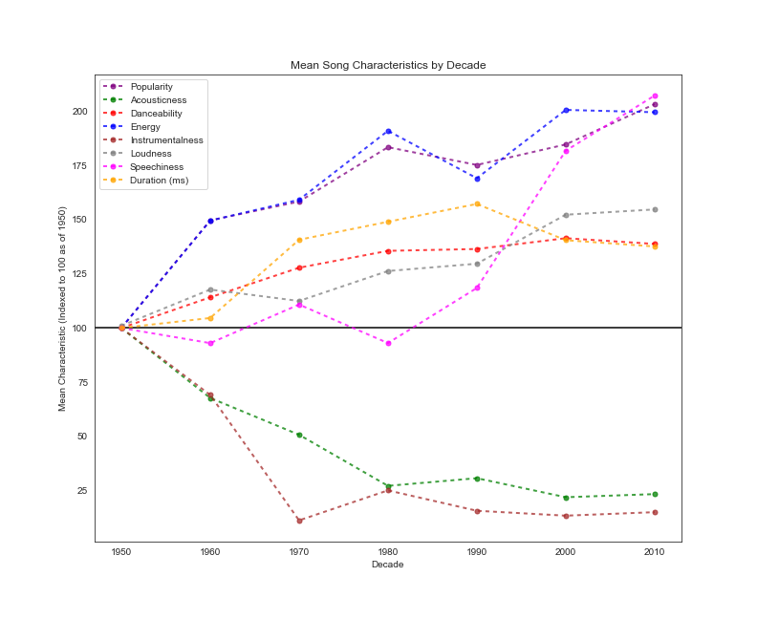
DATA ANALYSIS – Change in Mean Song Characteristics
Call Billboard Top 10 tracks in Spotify API
Append relevant data for each track:
Popularity
Audio feature: Accousticness*
Audio feature: Danceability*
Audio feature: Energy*
Audio feature: Instrumentalness*
Audio feature: Loudness*
Audio feature: Speechiness*
Duration
Group track release date by decade
Group mean of items (A-H) by decade
Index to 100 at start date of 1950

Slide 6
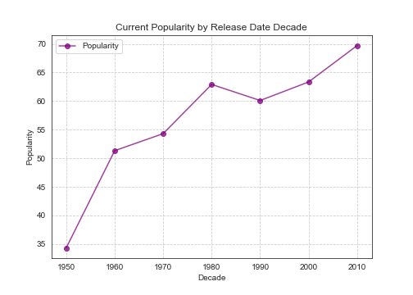
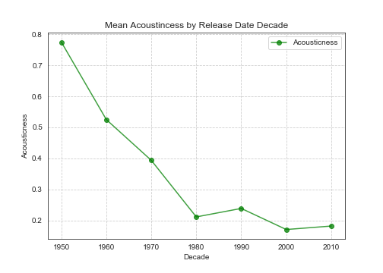
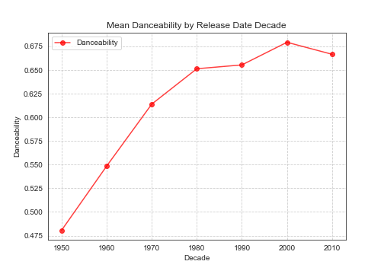
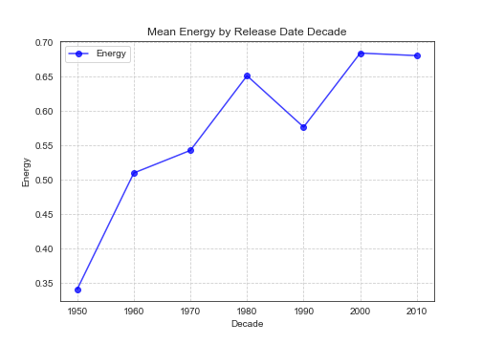
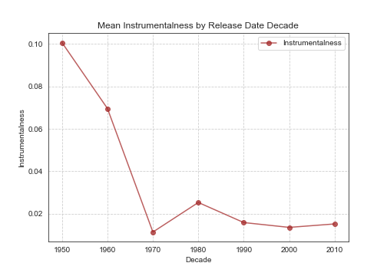
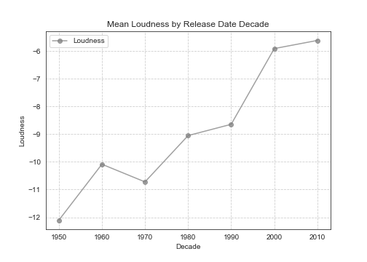
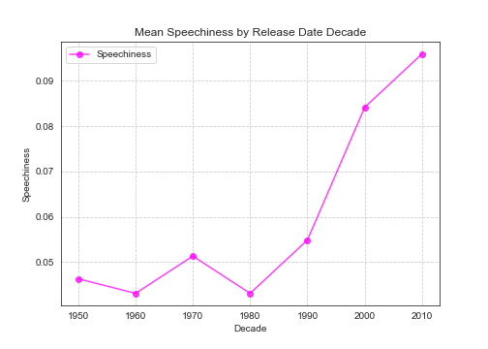
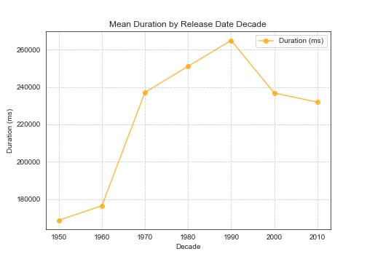
DATA ANALYSIS – Change in Mean Song Characteristics

Slide 7
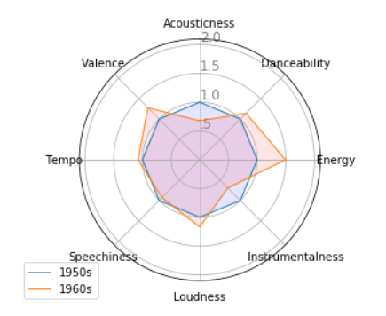
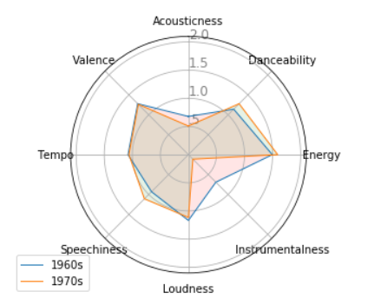
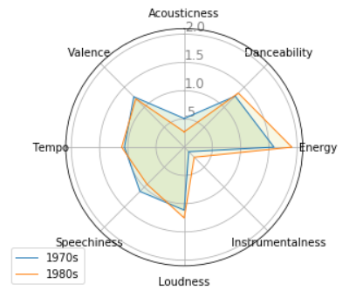
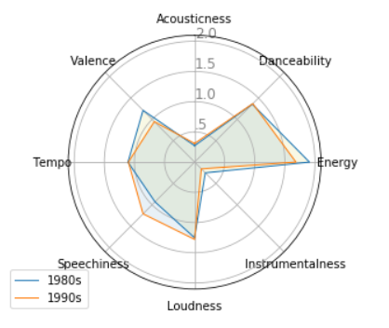
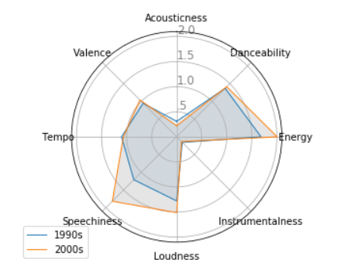
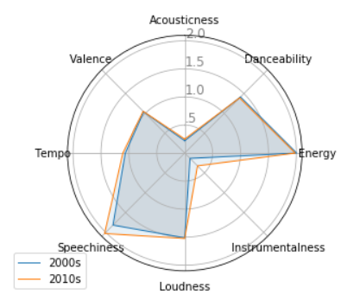
DATA ANALYSIS – Change in Mean Song Characteristics (Decade to Decade)

Slide 8
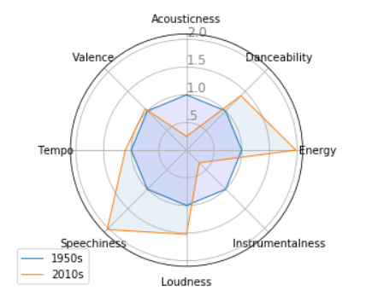
DATA ANALYSIS – Change in Mean Song Characteristics (2010s vs. 1950s)

Slide 9
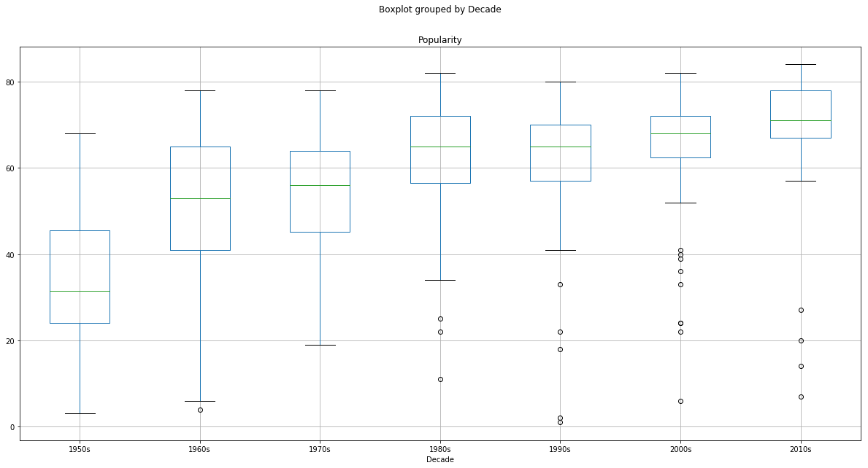
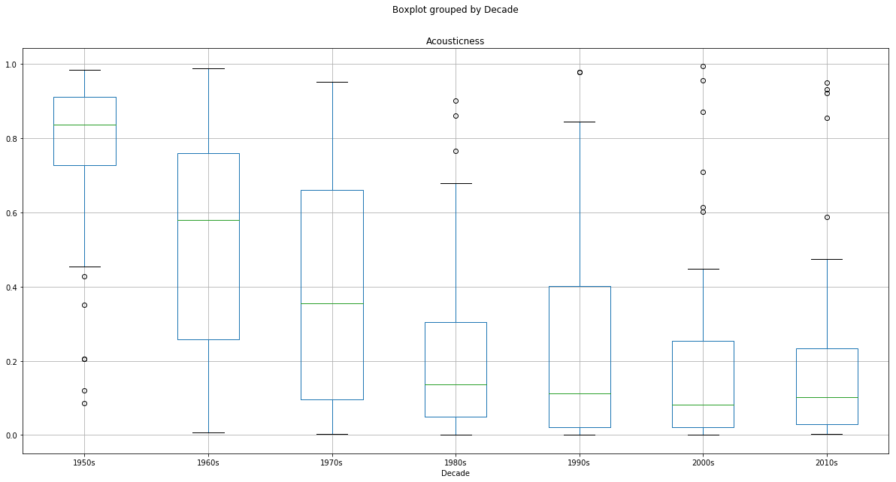
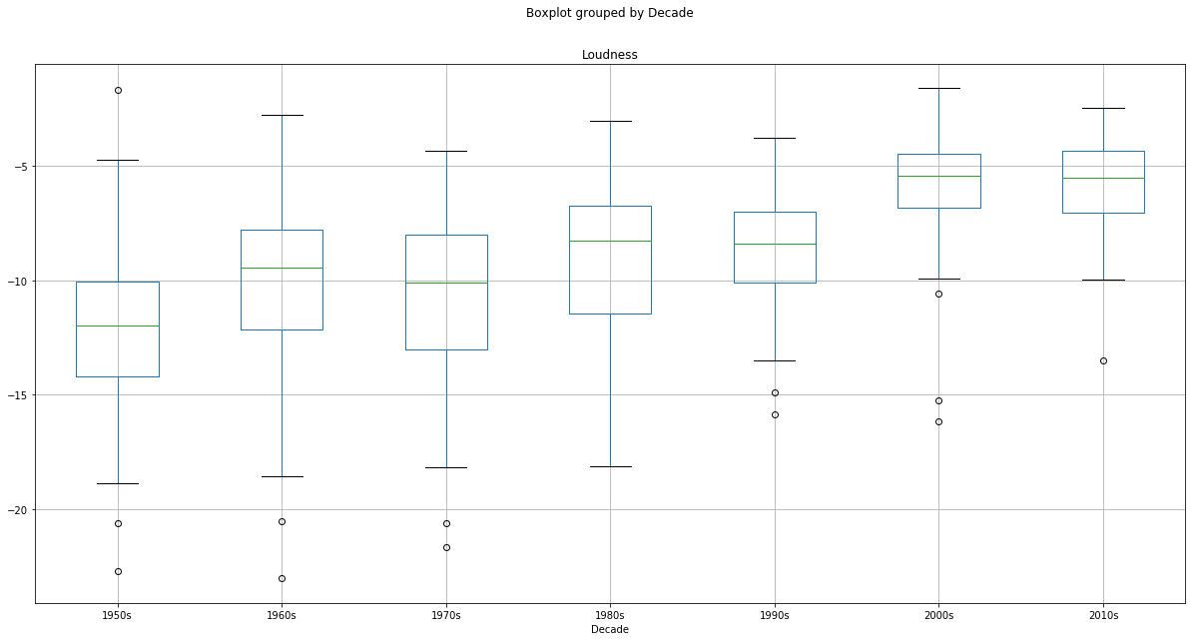
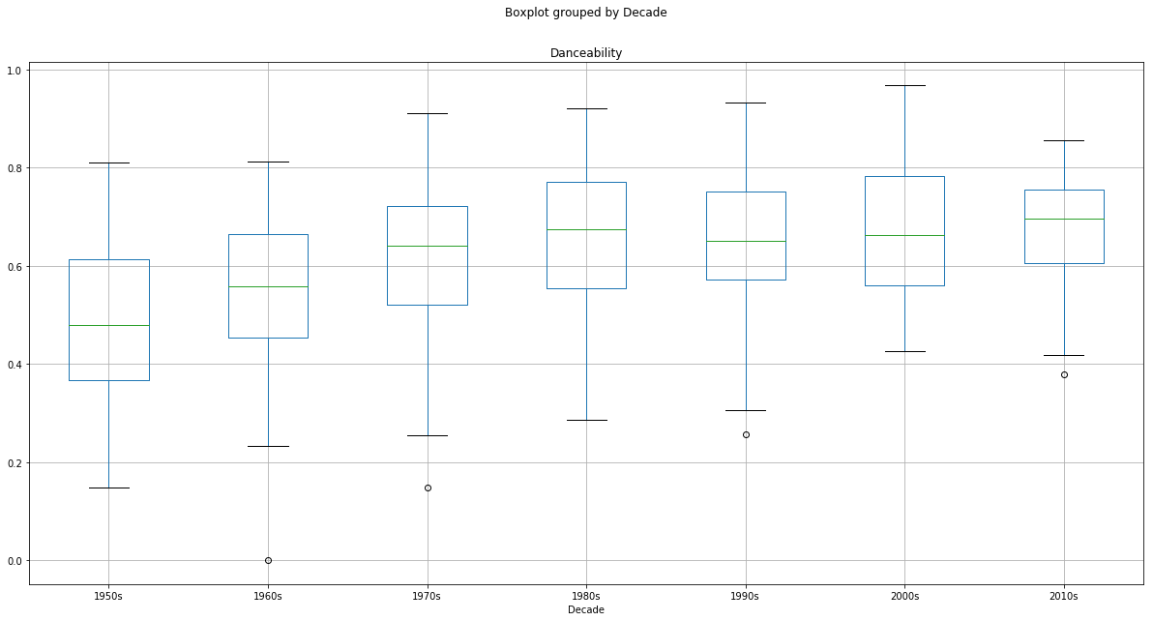
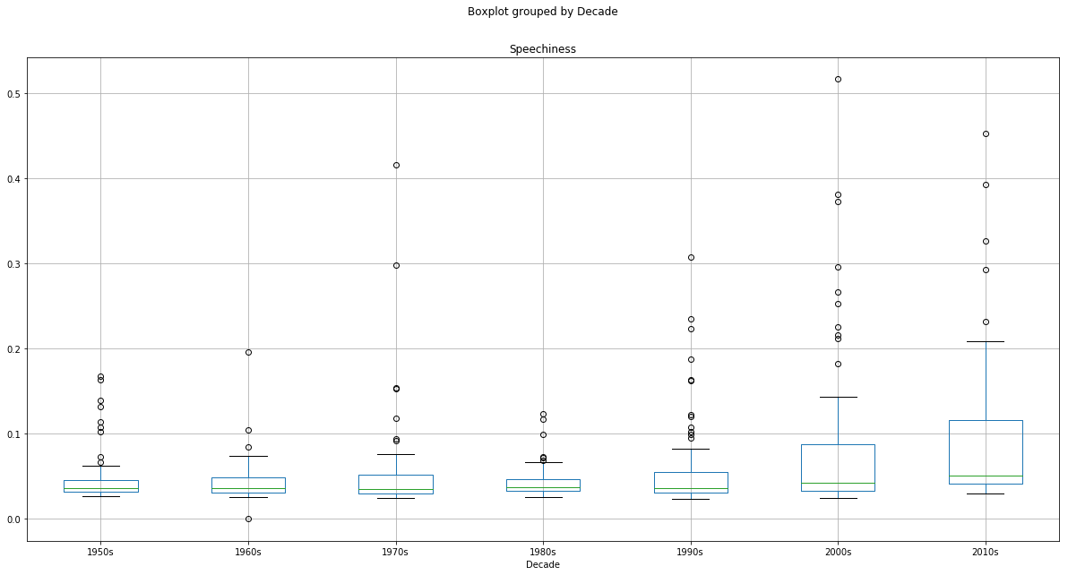
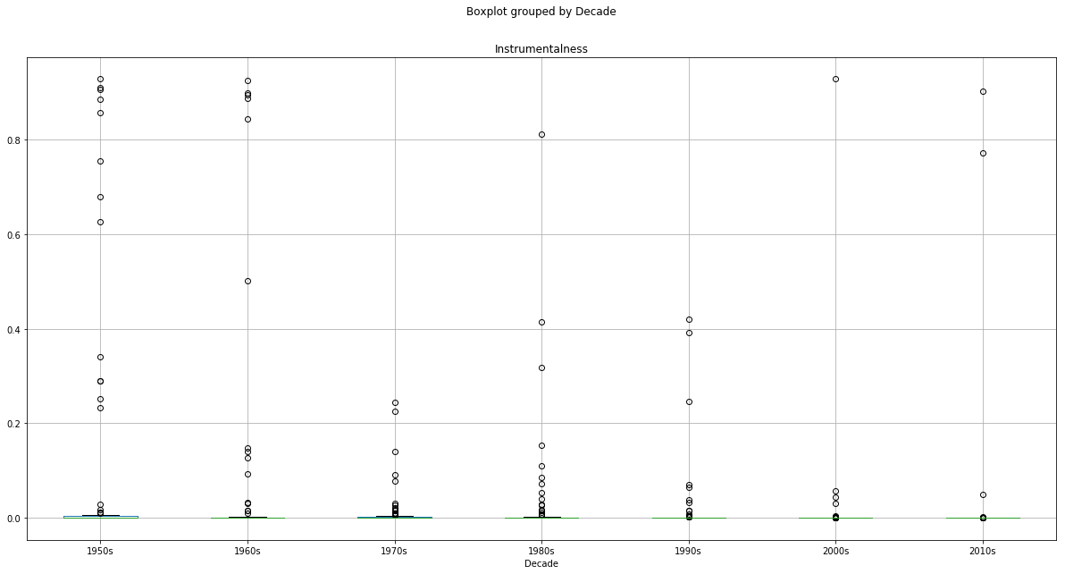
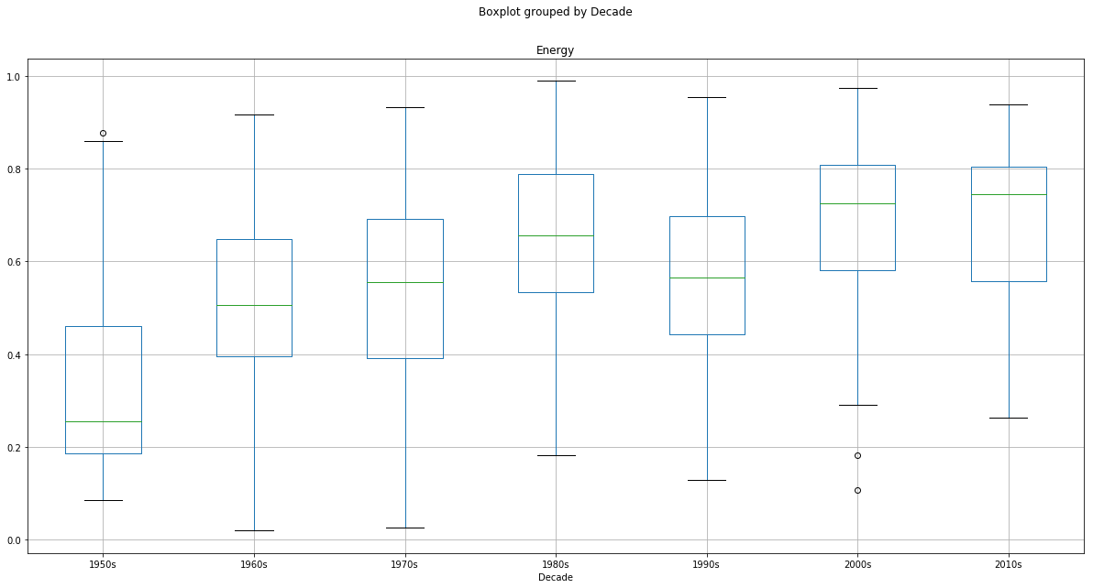
DATA ANALYSIS – Mean Song Characteristics Box Plots
statistic=44.02776316160487,
pvalue=7.583118030606852e-44
statistic=62.43245553737173,
pvalue=9.137622636023843e-59
statistic=43.757865000365335,
pvalue=1.2970276425938374e-43
statistic=9.24392991229993,
pvalue=1.1740280683446584e-09
statistic=19.26038775993707,
pvalue=2.1248779540381368e-20
statistic=4.0041488976277435,
pvalue=0.0006201004636514998
statistic=30.276871487542014,
pvalue=2.2825525652530776e-31

Slide 10
DATA ANALYSIS – Significance of Change in Mean Song Characteristics (vs. 1950s)
***
***
***
***
***
***
***
***
***
***
***
***
***
***
***
***
***
***
***
Key:
* = p<0.05
** = p<0.01
*** = p<0.001
***
***
***
***
***
***
***
***
***
***
**
**
**
**
*
***
***
***
***
Differences in mean song characteristics of 2010s are statistically significant vs. 1950s.
***
***
***
***
**
***

Slide 11
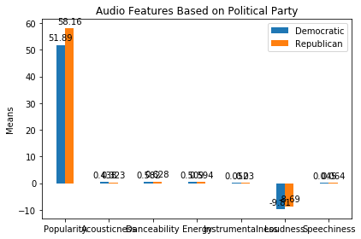
DATA ANALYSIS – Mean Song Characteristics (by White House Admin)
***
Differences in mean song characteristics are statistically significant across Republican vs. Democrat White House administrations.
Key:
* = p<0.05
** = p<0.01
*** = p<0.001
***
*
***
***
***
***

Slide 12
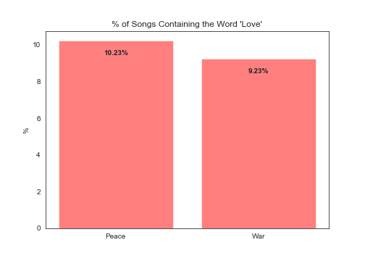
DATA ANALYSIS – Mean Song Characteristics (War vs. Peace)
Differences in mean song characteristics are not statistically significant in war vs. peace-time periods
In addition, and counter-intuitively, there was not a statistically significant difference in the frequency of the word ‘Love’ appearing in song titles during war vs. peace-time periods.

Slide 13
DATA ANALYSIS – Statistical Significance Summary

Slide 14
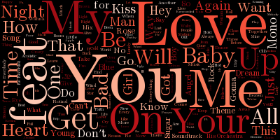
DATA ANALYSIS – Ancillary Insights
A manual review of Billboard Top 10 song titles for our entire data set highlighted pervasive usage of similar words across time
To confirm, we developed a word cloud
Rank:
‘you’ (n=52)
‘I’ (n = 45)
‘love’ (n=40)
‘me’ (n=29)
‘feat’ or ‘featuring’ (n=26)
‘heart’ (n=7)
Conclusions:
Hit songs get produced when they contain:
Emotion (i.e., ‘love)*
Guest cameo guest appearances (i.e., ‘feat’)

Slide 15
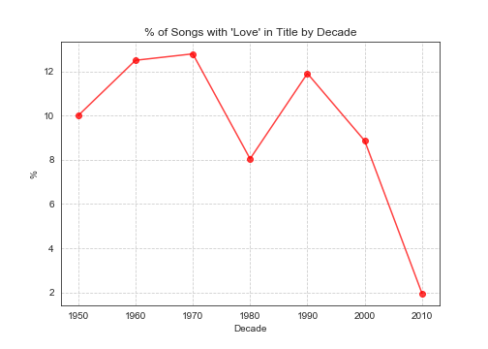
DATA ANALYSIS – Ancillary Insights cont…
REM claimed in the lyrics of its 1992 hit song “Everybody Hurts”:
If you feel like you're alone
No, no, no, you're not alone
However, our analysis suggests otherwise:
Only 2% of songs released in the 2010s decade contain the word ‘Love’
Vs. 8%-12% during the preceding 60 yrs
Conclusion:
Love songs disappearing as Tinder rules the 2010s?

Slide 16
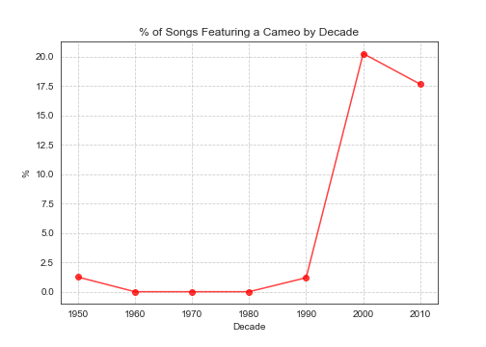
DATA ANALYSIS – Ancillary Insights cont…
As noted, song titles including the word ‘feat’ or ‘featuring’ showed up 26x in our data set:
However, prevalence was not evenly distributed across time:
Songs “featuring” other artists were non-existent in the Billboard Top 10 until 1990 but have since exploded
Conclusion:
Popular music preference has increasingly shifted toward tracks featuring guest appearance cameos

Slide 17



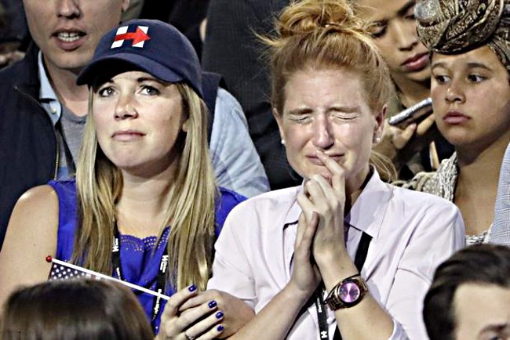
POST MORTEM
Problems encountered during analysis:
Inaccurate Spotify release dates
Forced to manually cross-check with Billboard Top 10 release date data in CSV file
Multiple instances of same track, or of same track performed by different artists, in Spotify API
Call on the first element returned
analysis.append(sp.audio_features
(new_uri[i]['tracks']["items"][0]["uri"]))
Originally intended to use Billboard’s annual Top 100 tracks but was too unwieldly for Spotify API, reducing sample #n of ~660 vs. 6,600
Further consideration:
Spotify lacks point-in-time and location-specific user data (i.e., popularity of a track ‘X’ in city ‘Y’ at times ‘t=0’ and ‘t=1’, but would be fascinating to analyze listening habits immediately before and after major events (i.e., what was popular in Berkeley, CA and other major Dem areas 11/7/16 vs. 11/9/16

